Slide 1

DATA STRUCTURE ALGORITHMS AND APPLICATIONS
Department of Computer Science
Prepared By:
Engr. Abdul Hafeez Babar
hafeezbabar@neduet.edu.pk
Thar Institute of Engineering, Science & Technology, Tharparkar
A Constituent college of NED university of engineering & Technology Karachi

Slide 2
ARRAY
(1 Dimensional , 2 Dimensional, Multi Dimensional)

Slide 3
Data Structure
Data structures are classified:
  Linear
    Static
    Dynamic
  Non-Linear
Linear:
is said to be linear if its elements form a sequence or linear list.
Two ways to represent Linear structure in memory:
  One way is to have the linear relationship between the elements represented by means of sequential memory locations.
    E.g. Array
  Another way is to have relationship between the elements represented by means of pointers or links.
    E.g. Linked Lists
Non-Linear
Data elements are hierarchically connected and are present at various levels.
E.g. Trees, Graphs

Slide 4
Operations on any Linear Structure
Traversal: Process each element in the list.
Search: Finding the location of the element with a given value or the record with a given key.
Insertion: Adding a new element to the list.
Deletion: Removing an element from the list.
Sorting: Arranging the elements in some type of order.
Merging: Combining two lists into a single list.
Notes:
Arrays are easy to traverse, search and sort, they are frequently used to store relatively permanent collection of data.
On the other hand, if the size of the structure and the data in the structure are constantly changing, then the array may not be as useful structure as the linked list.

Slide 5
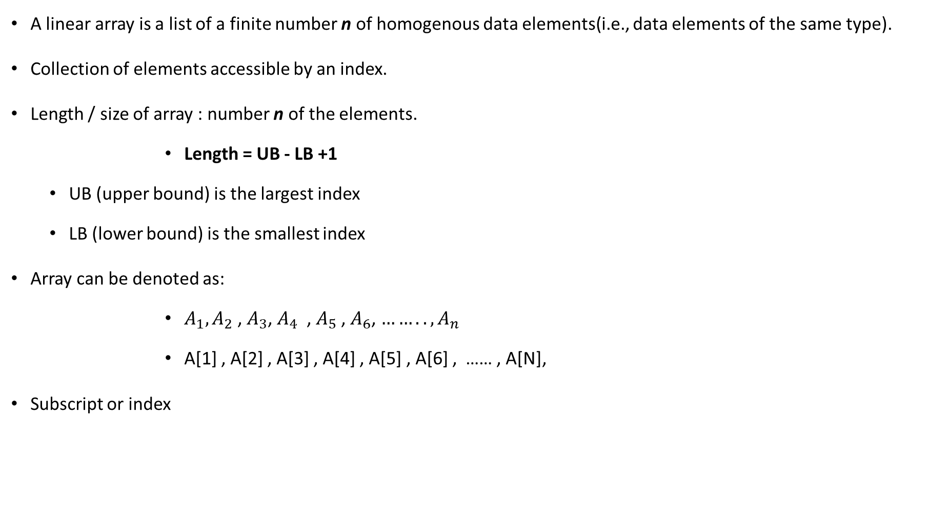
Linear Array
A linear array is a list of a finite number n of homogenous data elements(i.e., data elements of the same type).
Collection of elements accessible by an index.
Length / size of array : number n of the elements.
        Length = UB - LB +1
  UB (upper bound) is the largest index
  LB (lower bound) is the smallest index
Array can be denoted as:
        $A_{1},A_{2}$ , $A_{3}$, $A_{4}$ , $A_{5}$ , $A_{6}$, $……..,A_{n}$
        A[1] , A[2] , A[3] , A[4] , A[5] , A[6] , …… , A[N],
Subscript or index

Slide 6
Array:
In Java all arrays are dynamically allocated.
A Java array variable can also be declared like other variables with [] after the data type.
The variables in the array are ordered and each have an index beginning from 0.
Java array can be also be used as a static field, a local variable or a method parameter.
The size of an array must be specified by an int value and not long or short.
The direct superclass of an array type is Object.
Array can contain primitives (int, char, etc.) as well as object (or non-primitive) references of a class depending on the definition of the array.
In case of primitive data types, the actual values are stored in contiguous memory locations.
In case of objects of a class, the actual objects are stored in heap segment.
Notes:
dynamically allocated
int[] x = new int[someVariable];
This creates an array of a size that is not known at compile-time, meaning that the array (or rather the space for it) cannot be allocated by the compiler, but has to be allocated at run-time, i.e. dynamically. So when this line of code executes, some object on the heap will be created, and the normal garbage collection mechanism will eventually clean it up when it is no longer used.
In Java, the same dynamic mechanism is also used for arrays where the size is known at compile-time, but in theory -- and in other languages -- there are statically allocated arrays.

Slide 7
Array
Fixed Size (immutable)
Specific data type
Elements of array are stored in contiguous memory locations

Slide 8

Representation of Linear Array in Memory
Binary Number
int a = 5;
1 byte = 8 bits
int contain 4 bytes : 8 * 4 = 32 bits
000000………0101
address
8 bits
8 bits
8 bits
8 bits
100
101
102
103
00000000 | 00000000 | 00000000 | 00000101
100 | 101 | 102 | 103 | 104 | 105 | 106 | 107 | 108 | 109 | 110 | 111 | 112 | 113 | 114 | 115 | … | … | … | … | 121 | 122 | 123 | 124 | … | 297 | 298 | 299 | … | …
4 bytes
Address always into Hexadecimal: 0$×$677C0
Notes:
Used Array
Fixed Size
Unused Array

Slide 9
Operations on array
- Traversing
i Index start from 0
Int A[50] = {6,2,0,1,4};
0
1
2
3
4
A =
6 | 2 | 0 | 1 | 4
100
104
108
112
116
0
1
2
3
4
A =
100
104
108
112
116
0
1
2
3
4
100 | 101 | 102 | 103 | 104 | 105 | 106 | 107 | 108 | 109 | 110 | 111 | 112 | 113 | 114 | 115 | … | … | … | … | 121 | 122 | 123 | 124 | … | 297 | 298 | 299 | … | …

Slide 10
Operations on array
Program:
int a[50], size
for(i = 0 , i < size ; i++){
System.out.print(a[i])
}
- Traversing
Int a[50]
0
1
2
3
4
A =
6 | 2 | 0 | 1 | 4
100
104
108
112
116
0
1
2
3
4
100 | 101 | 102 | 103 | 104 | 105 | 106 | 107 | 108 | 109 | 110 | 111 | 112 | 113 | 114 | 115 | … | … | … | … | 121 | 122 | 123 | 124 | … | 297 | 298 | 299 | … | …

Slide 11
Operations on array
Program:
int a[50], size = 5, num = 10, pos =3
for(i = size -1 , i > = pos -1 ; i--){
System.out.print(a[i+1] = a[i])
}
a[pos-1] = num
size++
- Inserting
0
1
2
3
4
5
49
A =
6 | 2 | 0 | 4 | 5 | …. | … | ….
100
104
108
112
116
…
…
296
100 | 101 | 102 | 103 | 104 | 105 | 106 | 107 | 108 | 109 | 110 | 111 | 112 | 113 | 114 | 115 | … | … | … | … | 121 | 122 | 123 | 124 | … | 297 | 298 | 299 | … | …
Notes:
Position = 3
Num = 10
Then shift all the values and insert 10 in position 3.

Slide 12
Operations on array
Program:
int a[50], size = 5, pos =2
If (pos <=0 || pos >size){
System.out.println(“Invalid Position”)
}
else{
for( I = pos – 1, i<size -1 ; i++){
a[i] = a[i+1]
}
size--;
}
- Deleting
0
1
2
3
4
5
49
A =
6 | 2 | 0 | 4 | 5 | …. | … | ….
100
104
108
112
116
…
…
296
100 | 101 | 102 | 103 | 104 | 105 | 106 | 107 | 108 | 109 | 110 | 111 | 112 | 113 | 114 | 115 | … | … | … | … | 121 | 122 | 123 | 124 | … | 297 | 298 | 299 | … | …
Notes:
Position = 3
Num = 10
Then shift all the values and insert 10 in position 3.
From beginning
From end

Slide 13
Types of Array
1-Dimensional
2-Dimensional
Multi-Dimensional

Slide 14
1 Dimensional Array
  A one-dimensional array is also called a single dimensional array where the elements will be accessed in sequential order.
  This type of array will be accessed by the subscript of either a column or row index.
One Dimensional Array in java is always used with only one subscript([]).
A one-dimensional array behaves likes a list of variables.
Access the variables of an array by using an index in square brackets preceded by the name of that array.
Index value should be an integer.
A list of items can be given a common name individuals. Items can be referred using only one subscript Such variables are referred to a single subscript variable or a single dimensional array.
Linear arrays are also called single one dimensional array, since each element in the array is referred by a single subscript. In one dimensional array, the elements are represented in a single row.

Slide 15
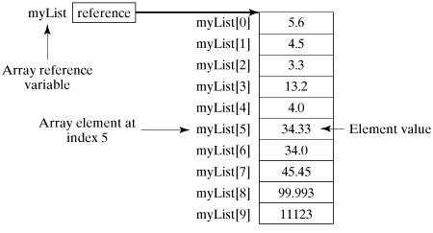
Declare, Initialize and Assigning of Array
Creation of an array may involve three steps:
1. Declaring the array
2. Creating memory
3. Putting value into memory
Following statement declares an array variable, myList, creates an array of 10 elements of double type and assigns its reference to myList.
Picture represents array myList. Here, myList holds ten double values and the indices are from 0 to 9.
double[ ] myList = new double[10];

Slide 16
Declaration of One-dimensional Array
Before using the array, we must declare it. Like normal variables, must provide data type of array and name of an array.
Data type means which type of elements we want to store in Array.
So, we must specify the data type of array according to our needs. We also need to specify the name of an array so that we can use it later by name
datatype[] arrayName;
or
datatype arrayName[];
or
datatype arrayName[];
int[] number;
Or
int number[];
or
int []number;
datatype can be a primitive data type(int, char, Double, byte etc.) or Non-primitive data (Objects).
arrayName is the name of an array
[ ] is called subscript.

Slide 17
Construction/Creation of One-dimensional array
For the creation of an array new keyword is used with a data type of array.
You must specify the size of the array.
The size should be an integer value or a variable that contains an integer value.
How many elements you can store an array directly depends upon the size of an array.
arrayName = new DataType[size];
new Datatype[size]: It creates an array in heap memory. Because an array is an object, so it stored in heap memory.
arrayName: Assignment operator assigns the newly created array to the reference of variable arrayName. We can access the elements of an array by use of array names.
number = new int[10]; // allocating memory to array

Slide 18
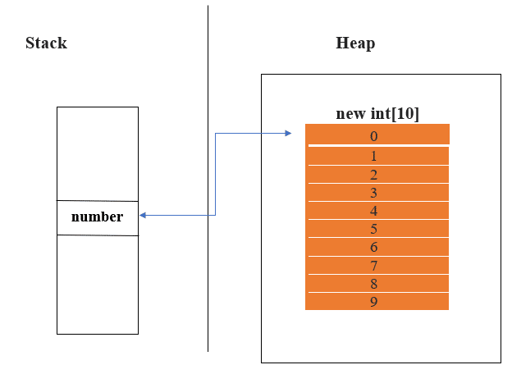
Construction/Creation of One-dimensional array
number = new int[10]; // allocating memory to array
In this example new int[10] creates a new array of int type in heap memory. The assignment operator assigns the array object to the reference variable number. Now you can access the array by use of the number. You can access each value of array by using numbers with subscript([]). We must have to use only one subscript([]) for One dimensional array in java.
Note: When we are creating a new array the elements in the array will automatically be initialized by their default values. For e.g. : zero (int types), false (boolean), or null (for object types).

Slide 19
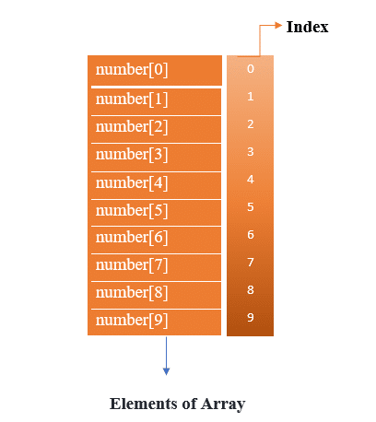
Memory Representation after Construction / Creation of Array
The index of an array starts from 0 and ends with length-1. The first element of an array is number[0], second is number[1] and so on. If the length of an array is n, the last element will be arrayName[length-1]. Since the length of the number array is 10, the last element of the array is number[9].

Slide 20
Initialization of One-dimensional array
You can also construct an array by initializing the array at declaration time. If you are initializing the array it is another way to construct an array.
dataType arrayName[] = {value1, value2, …valueN}
Some point about Initialization:
If you choose datatype of an array is int then values should be int type. It means a type of value is totally dependent on datatype of an array.
Value1 will be store at 0 indexes, value2 in 1 index and so on.
The size of the array depends upon how many values you are providing at the time of initialization.
int number[] = {11, 22, 33 44, 55, 66, 77, 88, 99, 100}
It’s created an array of int type as you see we are initializing it during declaration.

Slide 21
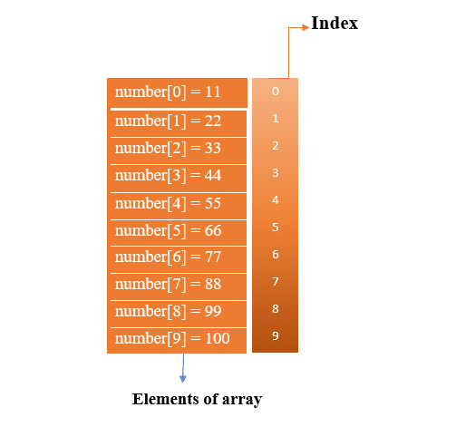
Memory Representation after Initialization
Example of an Array
public class MyExample
{
public static void main(String[] args)
{
Object obj = new int[] { 1, 2, 3 };
int[] someArray = (int[])obj;
for (int i : someArray)
System.out.print(i + " ");
}
}

Slide 22
Accessing the Elements of an Array
Accessing an array element by referring to the index number.
Other Example:
public class Main {
public static void main(String[] args) {
String[] cars = {"Volvo", "BMW", "Ford", "Mazda"};
System.out.println(cars[0]);
}
}
String[] cars = {"Volvo", "BMW", "Ford", "Mazda"};
System.out.println(cars[0]);
// Outputs Volvo

Slide 23
Changes on Array Elements
To change the value of a specific element, refer to the index number.
Example:
String[] cars = {"Volvo", "BMW", "Ford", "Mazda"};
cars[0] = "Opel";
System.out.println(cars[0]);
// Now outputs Opel instead of Volvo
cars[0] = "Opel";

Slide 24
Array Length
To find out how many elements an array has, use the length property.
Example:
String[ ] cars = {"Volvo", "BMW", "Ford", "Mazda"};
System.out.println(cars.length);
// Outputs 4

Slide 25
Loop Through an Array / Processing of Array
When processing array elements, we often use either for loop or foreach loop because all of the elements in an array are of the same type and the size of the array is known.
You can loop through the array elements with the for loop, and use the length property to specify how many times the loop should run.
Example:
String[] cars = {"Volvo", "BMW", "Ford", "Mazda"};
for (int i = 0; i < cars.length; i++)
{
System.out.println(cars[i]);
}
Notes:
public class TestArray {
public static void main(String[] args) {
double[] myList = {1.9, 2.9, 3.4, 3.5};
// Print all the array elements
for (int i = 0; i < myList.length; i++) {
System.out.println(myList[i] + " ");
}
// Summing all elements
double total = 0;
for (int i = 0; i < myList.length; i++) {
total += myList[i];
}
System.out.println("Total is " + total);
// Finding the largest element
double max = myList[0];
for (int i = 1; i < myList.length; i++) {
if (myList[i] > max) max = myList[i];
}
System.out.println("Max is " + max); }
}
This will produce the following result −
Output
1.92.93.43.5
Total is 11.7
Max is 3.5

Slide 26
Loop Through an Array with For-Each
JDK 1.5 introduced a new for loop known as foreach loop or enhanced for loop, which enables you to traverse the complete array sequentially without using an index variable.
There is also a "for-each" loop, which is used exclusively to loop through elements in arrays:
Syntax
for (type variable : arrayname) {
...
}
Example:
String[] cars = {"Volvo", "BMW", "Ford", "Mazda"};
for (String i : cars) {
System.out.println(i);
}
Notes:
JDK 1.5 introduced a new for loop known as foreach loop or enhanced for loop, which enables you to traverse the complete array sequentially without using an index variable.
public class TestArray {
public static void main(String[] args) {
double[] myList = {1.9, 2.9, 3.4, 3.5};
// Print all the array elements
for (double element: myList) {
System.out.println(element);
}
}
}
This will produce the following result −
Output
1.9
2.9
3.4
3.5

Slide 27
Passing Arrays to Methods
you can pass primitive type values to methods, you can also pass arrays to methods. For example, the following method displays the elements in an int array.
Example
public static void printArray(int[] array) {
for (int i = 0; i < array.length; i++) {
System.out.print(array[i] + " ");
}
}
You can invoke it by passing an array. For example, the following statement invokes the printArray method to display 3, 1, 2, 6, 4, and 2.
Example
printArray(new int[]{3, 1, 2, 6, 4, 2});

Slide 28
Returning an Array from a Method
A method may also return an array. For example, the following method returns an array that is the reversal of another array.
Example
public static int[] reverse(int[] list)
{
int[] result = new int[list.length];
for (int i = 0, j = result.length - 1; i < list.length; i++, j--) {
result[j] = list[i];
}
return result;}

Slide 29
What happens if we try to access element outside the array size?
JVM throws ArrayIndexOutOfBoundsException to indicate that array has been accessed with an illegal index. The index is either negative or greater than or equal to size of array.
Example:
public class TestArrayException{
public static void main(String args[]){
int arr[]={50,60,70,80};
for(inAt i=0;i<=arr.length;i++){
System.out.println(arr[i]);
}
}}

Slide 30
Arrays of Objects:
An array can store primitive or non- primitive data types.
Example:
To store a record of students.
Each Student has some information like rollNo, name, className, etc. So can store objects of Student in an Array. That’s why we are calling this Array of objects. An Array of objects each index value can store an object.
Create a class Student that holds information about a student. We want to hold a number of student records so we will use an array of objects in the java.

Slide 31
Arrays of Objects:
public class Student
{
int rollNo;
String name;
String className;
public int getRollNo() {
return rollNo;
}
public void setRollNo(int rollNo) {
this.rollNo = rollNo;
}
public String getName() {
return name;
}
public void setName(String name) {
this.name = name;
}
public String getClassName() {
return className;
}
public void setClassName(String className) {
this.className = className;
}
}
Example:

Slide 32
Arrays of Objects:
Example:
class StudentRecord
{
public static void main(String[] args)
{
Student[] recordOfStudent = new Student[3];
// First student record
Student firstStudent = new Student();
firstStudent.setRollNo(1);
firstStudent.setName("Ravi kant");
firstStudent.setClassName("MCA");
recordOfStudent[0] = firstStudent;
// Second student record
Student secondStudent = new Student();
secondStudent.setRollNo(2);
secondStudent.setName("Rama");
secondStudent.setClassName("MCA");
recordOfStudent[1] = secondStudent;
// Third student record
Student thirdStudent = new Student();
thirdStudent.setRollNo(3);
thirdStudent.setName("Radhe");
thirdStudent.setClassName("MCA");
recordOfStudent[2] = thirdStudent;
// print record of all student
displayStduentRecord(recordOfStudent);
}
public static void displayStduentRecord(Student[] recordOfStudent)
{
for(int i = 0; i < recordOfStudent.length; i++)
{
Student stduent = recordOfStudent[i];
System.out.println("Student rollNo = "+stduent.getRollNo());
System.out.println("Student Name = "+stduent.getName());
System.out.println("Student class = "+stduent.getClassName());
}
}
}
Notes:
Output:
Student rollNo = 1
Student Name = Ravi kant
Student class = MCA
Student rollNo = 2
Student Name = Rama
Student class = MCA
Student rollNo = 3
Student Name = Radhe
Student class = MCA

Slide 33
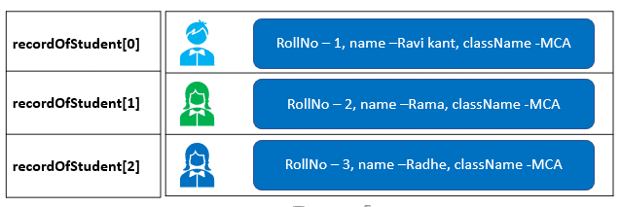
Arrays of Objects:
Student[] recordOfStudent = new Student[3];
It can store three objects of Student. You can change the size of the Array according to your requirements. After the creation of an array of objects, we initialized the value of each index.
recordOfStudent[0] = firstStudent;
recordOfStudent[1] = firstStudent;
recordOfStudent[2] = firstStudent;
Now, the recordOfStudent contains three objects of Student. We are displaying the record of the students by accessing the Array. You can simply access an array by use of subscripts.

Slide 34
2 Dimensional Array
A 2D array is stored in the computer's memory one row following another.
The address of the first byte of memory is considered as the memory location of the entire 2D array.
Knowing the address of the first byte of memory, the compiler can easily compute to find the memory location of any other elements in the 2D array provided the number of columns in the array is known.
  If each data value of the array requires B bytes of memory, and if the array has C columns, then the memory location of an element such as score[m][n] is (m*c+n)*B from the address of the first byte.
Note that to find the memory location of any element, there is no need to know the total number of rows in the array, i.e. the size of the first dimension. Of course the size of the first dimension is needed to prevent reading or storing data that is out of bounds.
Again one should not think of a 2D array as just an array with two indexes. You should think of it as an array of arrays.

Slide 35
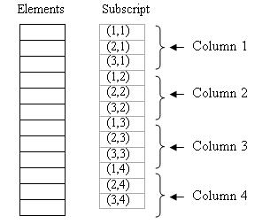
2 Dimensional Array
A 2D array’s elements are stored in continuous memory locations. It can be represented in memory using any of the following two ways:
1.Column-Major Order
2. Row-Major Order
Column-Major Order:
In this method the elements are stored column wise, i.e. m elements of first column are stored in first m locations, m elements of second column are stored in next m locations and so on. E.g.
A 3 x 4 array will stored as illustrated in Fig.

Slide 36
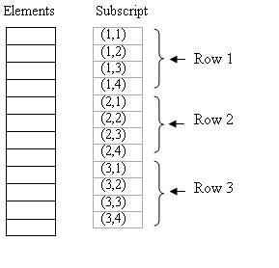
2 Dimensional Array
2.Row-Major Order:
In this method the elements are stored row wise, i.e. n elements of first row are stored in first n locations, n elements of second row are stored in next n locations and so on. E.g.
A 3 x 4 array will stored as illustrated in Fig.

Slide 37
Declaration of 2 Dimensional Array
datatype[][] arrayName;
Or
datatype arrayName[][];
Or
datatype [][]arrayName;
int[][] number;
Or
int number[][];
Or
int [][]number;
Here int is datatype and number is the name of the two-dimensional array. Two subscripts [][] is used to defined as a two-dimensional array.

Slide 38
Construction / Creation of two-dimensional array
The new keyword is used with the data type of array.
There are two subscripts for the size of an array, is the size of the matrix.
The first subscript is used to define the number of rows in the matrix.
Second one is for the number of columns.
You must specify the size of the array because how many number elements you can store an array directly depends upon the size of the array.
arrayName = new DataType[size][size];
new Datatype[size][size] : It creates an array in heap memory. Because an array is an object, so it stored in heap memory. The first subscript size will define the number of row and second subscript used for the number of columns.
arrayName: Assignment operator assigns the newly created array to the reference of variable arrayName.
number = new int[3][3]; // allocating memory to array

Slide 39
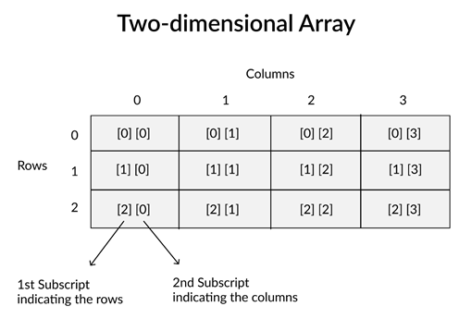
Memory Representation after Construction
For example
Int [3][4]
The first element of array is number[0][0], second is number[0][1] and so on.

Slide 40
Initialization of two-dimensional array
You can provide value to an array at declaration time.
Syntax of the initialization of two-dimensional array it differs from the one-dimensional array.
dataType arrayName[][] = {
{value1, value2, …valueN},
{value1, value2, …valueN},
{value1, value2, …valueN},
};
It’s created an array and initializes it during declaration.
int[][] number = {
{11, 22, 33},
{44, 55, 66},
{77, 88, 99},
};

Slide 41
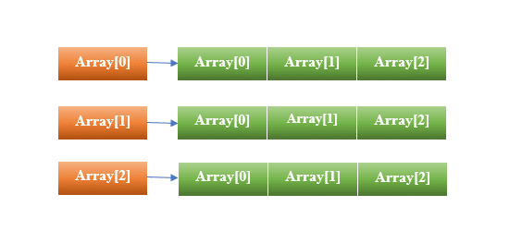
Memory Representation after Initialization
 | Column 1 | Column 2 | Column 3
Row 1 | number[0][0]=11 | number[0][1]=22 | number[0][2]=33
Row 2 | number[1][0]=44 | number[1][1]=55 | number[1][2]=66
Row 3 | number[2][0]=77 | number[2][1]=88 | number[2][2]=99
Two-dimensional array is an array of array.

Slide 42
Accessing Elements of Two Dimensional Array
Syntax:
x[row_index][column_index]
For example:
int[][] arr = new int[10][20]; arr[0][0] = 1;
Example:
class GFG {
public static void main(String[] args)
{
int[][] arr = { { 1, 2 }, { 3, 4 } };
System.out.println("arr[0][0] = " + arr[0][0]);
}
}
Output:
arr[0][0] = 1

Slide 43
Example of a Two-dimensional array:
public class ExampleOfTwoDimentionalArray {
public static void main(String[] args)
{
// Creation of Array with initilization
int[][] number = {
{1, 2, 3},
{4, 5, 6},
{7, 8, 9},
};
String[][] names = {
{"Hello1", "Hello2", "Hello3"},
{"Hello4","Hello5", "Hello6"},
{"Hello7", "Hello8", "Hello9"},
};
// You can initilize the Array in another way
/*
* int[][] number = new int[] { {1, 2, 3}, {4, 5, 6}, {7, 8, 9}, }; String[][]
* names = { {"Hello1", "Hello2", "Hello3"}, {"Hello4","Hello5", "Hello6"},
* {"Hello7", "Hello8", "Hello9"}, };
*/
// Accessing of Array
for(int i = 0; i < 3; i++)
{
for(int j = 0; j < 3; j++)
{
System.out.println(number[i][j]);
System.out.println(names[i][j]);
}
}
}
}
Notes:
Output: 1
Hello1
2
Hello2
3
Hello3
4
Hello4
5
Hello5
6
Hello6
7
Hello7
8
Hello8
9
Hello9

Slide 44
Multidimensional Arrays
A multidimensional array is an array containing one or more arrays.
Multidimensional arrays are arrays of arrays with each element of the array holding the reference of other array.
These are also known as Jagged Arrays.
A multidimensional array is created by appending one set of square brackets ([]) per dimension.
int[][] intArray = new int[10][20]; //a 2D array
Or
matrixint[][][] intArray = new int[10][20][10]; //a 3D array
Notes:
Examples:

Slide 45
3 Dimensional Array / Multi Dimensional Array
Higher dimensional arrays should be similarly interpreted. For example a 3D array should be thought of as an array of arrays of arrays.
To find the memory location of any element in the array relative to the address of the first byte, the sizes of all dimensions other than the first must be known.
Knowledge of how multidimensional arrays are stored in memory helps one understand how they can be initialized, and how they can be passed as function arguments.

Slide 46
Representation of 3-D Array
int a[3] [3]
3 *3
int a [2][3] [3]
3 *3
3 *3
0 | 1
a[0][0][2];

Slide 47
Memory representation of 3D Array
Example: 2* 4* 3 array B . The number of elements in B = 2*4*3 = 24.
These 24 elements of B are visually pictured as in below given figure. They appear in three layers called pages. These three subscripts are row, column, page.
Page , Row, Column
Memory representation:
PAGE 3
B(3,1,1) | B(3,1,2) | B(3,1,3) | B(3,1,4)
B(3,2,1) | B(3,2,2) | B(3,2,3) | B(3,2,4)
PAGE 2
B(2,1,1) | B(2,1,2) | B(2,1,3) | B(2,1,4)
B(2,2,1) | B(2,2,2) | B(2,2,3) | B(2,2,4)
PAGE 1
B(1,1,1) | B(1,1,2) | B(1,1,3) | B(1,1,4)
B(1,2,1) | B(1,2,2) | B(1,2,3) | B(1,2,4)
B [3] [2] [4]
Fig: Column Major Representation

Slide 48
Memory representation of 3D Array
Example: 2* 4* 3 array B . The number of elements in B = 2*4*3 = 24.
These 24 elements of B are visually pictured as in below given figure. They appear in three layers called pages. These three subscripts are row, column, page.
Page , Row, Column
Memory representation:
PAGE 3
B(3,1,1) | B(3,1,2) | B(3,1,3) | B(3,1,4)
B(3,2,1) | B(3,2,2) | B(3,2,3) | B(3,2,4)
PAGE 2
B(2,1,1) | B(2,1,2) | B(2,1,3) | B(2,1,4)
B(2,2,1) | B(2,2,2) | B(2,2,3) | B(2,2,4)
PAGE 1
B(1,1,1) | B(1,1,2) | B(1,1,3) | B(1,1,4)
B(1,2,1) | B(1,2,2) | B(1,2,3) | B(1,2,4)
Fig: Row Major Representation

Slide 49
Multidimensional Arrays
We can also use a for loop inside another for loop to get the elements of a two-dimensional array (we still have to point to the two indexes):
Example
class Array {
public static void main(String[] args)
{
int[][][] arr = { { { 1, 2 }, { 3, 4 } }, { { 5, 6 }, { 7, 8 } } };
for (int i = 0; i < 2; i++)
for (int j = 0; j < 2; j++)
for (int z = 0; z < 2; z++)
System.out.println("arr[" + i
+ "]["
+ j + "]["
+ z + "] = "
+ arr[i][j][z]);
}
}

Slide 50

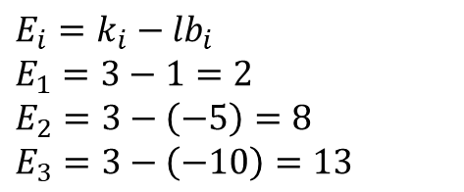
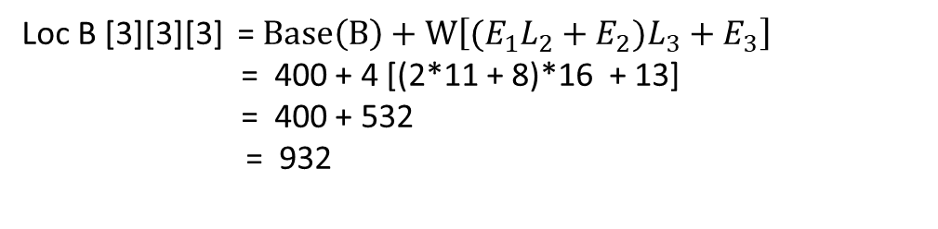
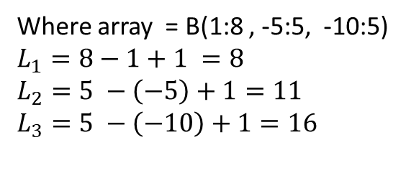
Address calculation in 3-D Array
Example:
Consider the element B(3,3,3) in B. where array B(1:8, -5:5, -10:5). Find the effective indices $E_{1} ,E_{2}$, $E_{3}$ and the address of element B(3,3,3) . Assuming Base (B) = 400 and word size = 4 words per memory.
Row Major Matrix
Loc B [3][3][3] = ?
B (3, ,3 , 3)
$k_{1},$ $k_{2}$, $k_{3}$
Formula:
$$LOC A\left[i\right]\left[j\right]\left[k\right]=Base\left(A\right)+W\left[{(E}_{1}L_{2}+E_{2})L_{3}+E_{3}\right]$$
$$E_{i}=k_{i}−{lb}_{i}$$
$$E_{1}=3−1=2$$
$$E_{2}=3−\left(−5\right)=8$$
$$E_{3}=3−\left(−10\right)=13$$
Where array = B(1:8 , -5:5, -10:5)
$$L_{1}=8−1+1 =8$$
$$L_{2}=5 −\left(−5\right)+1=11$$
$$L_{3}=5 −\left(−10\right)+1=16$$
So, in row major order:
Loc B [3][3][3] = $Base\left(B\right)+W\left[{(E}_{1}L_{2}+E_{2})L_{3}+E_{3}\right]$
= 400 + 4 [(2*11 + 8)*16 + 13]
= 400 + 532
= 932

Slide 51
Advantages of Array
Code Optimization: It makes the code optimized, we can retrieve or sort the data efficiently.
Random access: We can get any data located at an index position.
Size Limit: We can store only the fixed size of elements in the array. It doesn't grow its size at runtime. To solve this problem, collection framework is used in Java which grows automatically.
It is better and convenient way of storing the data of same datatype with same size.
It allows us to store known number of elements in it.
It allocates memory in contiguous memory locations for its elements. It does not allocate any extra space/ memory for its elements. Hence there is no memory overflow or shortage of memory in arrays.
Iterating the arrays using their index is faster compared to any other methods like linked list etc.
It allows to store the elements in any dimensional array – supports multidimensional array.

Slide 52
Disadvantages of Array
Array size is fixed: The array is static, which means its size is always fixed. The memory which is allocated to it cannot be increased or decreased. Below is the program for the same:
Array is homogeneous:The array is homogeneous, i.e., only one type of value can be store in the array. For example, if an array type “int“, can only store integer elements and cannot allow the elements of other types such as double, float, char so on.
Array is Contiguous blocks of memory: The array stores data in contiguous(one by one) memory location.
Predetermining the size of the array is a must.
· There is a chance of memory wastage or shortage.
· To delete one element in the array, we need to traverse throughout the array.
· To delete one element in the array, we need to traverse throughout the array.

Slide 53


